Slide 1
Cloud Computing
Samanvitha Ramayanam

Slide 2
What is Cloud Computing ?
An emerging computing paradigm where data and services reside in massively scalable data centers and can be ubiquitously accessed from any connected devices over the internet.

Slide 3
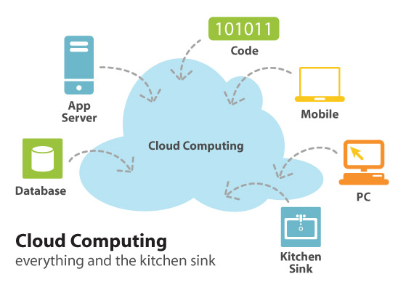

Slide 4

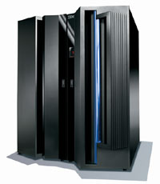
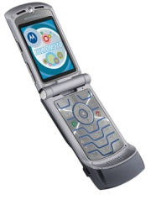
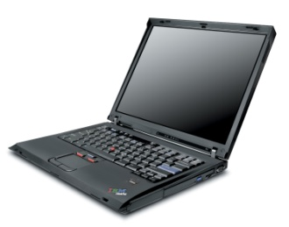

Slide 5
Gartner defines cloud computing as
"a style of computing in which massively scalable IT-related capabilities are provided 'as a service' using Internet technologies to multiple external customers."

Slide 6

CHARACTERISTICS
Sold on demand
Elastic
Service is fully managed by the provider
Virtual
Scalable
Efficient
Flexible

Slide 7
Types of clouds
Public
Private

Slide 8
New aspects from a hardware point of view:
1. The illusion of infinite computing resources available on demand.
2. The elimination of an up-front commitment
by Cloud users.
3. The ability to pay for use of computing
resources on a short-term basis as needed
and release them as needed.

Slide 9
These services are broadly divided into three categories :
Infrastructure-as-a-Service (IaaS)
Platform-as-a-Service (PaaS)
Software-as-a-Service (SaaS)

Slide 10
Infrastructure-as-a-service
It provides virtual server instances with unique IP addresses and blocks of storage on demand.
Customers use the provider's application program interface (API) to start, stop, access and configure their virtual servers and storage.

Slide 11
Platform-as-a-service
It is defined as a set of software and product development tools hosted on the provider's infrastructure.
Developers create applications on the provider's platform over the Internet.
PaaS providers may use APIs, website portals or gateway software installed on the customer's computer.

Slide 12
Software-as-a-service
The vendor supplies the hardware infrastructure, the software product and interacts with the user through a front-end portal.
Service providers enjoy greatly simplified software installation and maintenance and centralized control over versioning
End users can access the service “anytime, anywhere”, share data and collaborate more easily, and keep their data stored safely in the infrastructure.

Slide 13
SaaS
Utility computing
Cloud computing

Slide 14
Why now, not then?
New Technology Trends and Business Models
New Application Opportunities:
Mobile interactive applications
Parallel batch processing
The rise of analytics
Extension of compute-intensive desktop applications

Slide 15
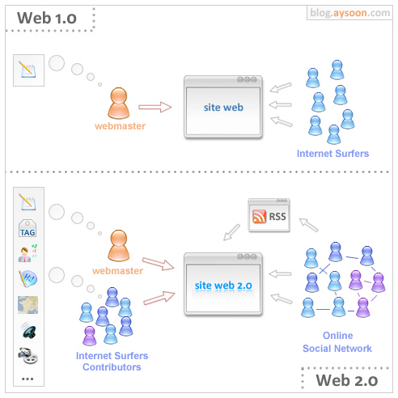

Slide 16
Why now, not then?
New Technology Trends and Business Models
New Application Opportunities:
Mobile interactive applications
Parallel batch processing
The rise of analytics
Extension of compute-intensive desktop applications

Slide 17
Advantages of cloud computing
Lower-Cost Computers for Users
Improved Performance
Lower IT Infrastructure Costs
Fewer Maintenance Issues
Lower Software Costs
Instant Software Updates
Increased Computing Power
Unlimited Storage Capacity
Increased Data Safety
Improved Compatibility Between Operating Systems
Improved Document Format Compatibility
Easier Group Collaboration
Universal Access to Documents
Latest Version Availability
Removes the Tether to Specific Devices

Slide 18
Uses of cloud computing
Top uses of the cloud are:
IT management
Collaboration
Personal and business applications
Application development and deployment
Server and storage capacity

Slide 19
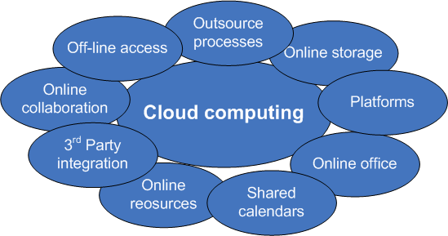

Slide 20
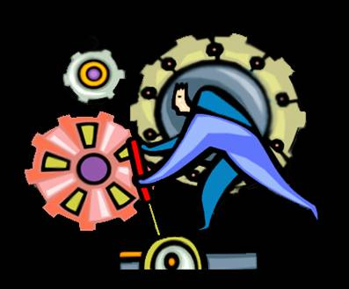
Example of How the Cloud Drives Innovation
Speed time to market for new offerings by exploiting collaboration technology to co-create and gather rapid feedback on new offerings
Lower barriers to IT by leveraging Cloud to provide incubation environment for new prototypes
Expand sources of innovation with a network of partners, customers, researchers, and academia

Slide 21

Who would become a Cloud Computing provider, and why?
Make a lot of money.
Leverage existing investment.
Defend a franchise.
Leverage customer relationships.
Become a platform

Slide 22
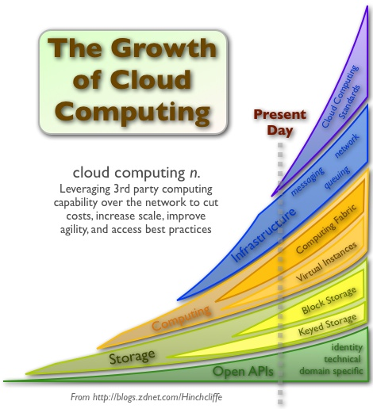

Slide 23

Obstacles and opportunities
1. Obstacle : Availability of Service
Opportunity : Use Multiple Cloud Providers
Use Elasticity to Prevent DDOS

Slide 24

2. Obstacle : Data Lock-In
Opportunity :
1. Standardize APIs
2. Compatible Software to enable Surge
Computing

Slide 25

3. Obstacle : Data Confidentiality and Auditability
Opportunity : Deploy
1. Encryption
2. VLANs
3. Firewalls

Slide 26
4. Obstacle : Data Transfer Bottlenecks
Opportunity : FedExing Disks
Data Backup/Archival
Higher Bandwidth Switches
5. Obstacle : Performance Unpredictability
Opportunity : Improved Virtual Machine Support
Flash Memory
Gang Schedule Virtual Machines

Slide 27

6. Obstacle : Scalable Storage
Opportunity : Invent Scalable Store
7. Obstacle : Bugs in Large Distributed Systems
Opportunity : Invent Debugger that relies on
Distributed Virtual Machines

Slide 28
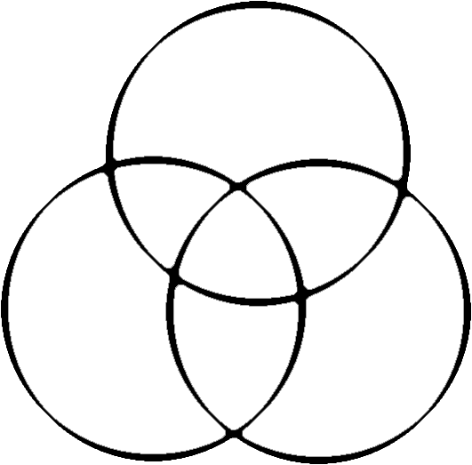

Intelligence
Computation
Communication

Slide 29
CONCLUSION
The long dreamed vision of computing as a utility is finally emerging with the emergence of cloud computing.
Although Cloud Computing providers may run afoul of the obstacles present, we believe that soon they will successfully navigate these challenges by exploiting the opportunities that correspond to those obstacles.

Slide 30
REFERENCES
Wikipedia
searchcloudcomputing.techtarget.com/.../0,,sid201_gci1287881,00.html
www.infoworld.com/.../cloud-computing/what-cloud-computing-really-means-031 -
thecloudcomputing.org/2009/2/Cloud-II-2009-CFP-0522-2009.
www.dabcc.com/article.aspx?id=9962
Google.com

Slide 31
Thank YOU!!

